Slide 1



From Bottlenecks to Breakthroughs: Transforming DevOps Testing with GenAI
Vadivelu Balasundaram
Ajithkumar Lakshmanan

Slide 2
{agenda}
Current DevOps Pipeline Challenges
Why Traditional Pipelines Struggle
How GenAI Enhances the DevOps Pipeline
GenAI solution Architecture
GenAI Across Each Pipeline Stage
Benefits & Key Takeaways

Slide 3

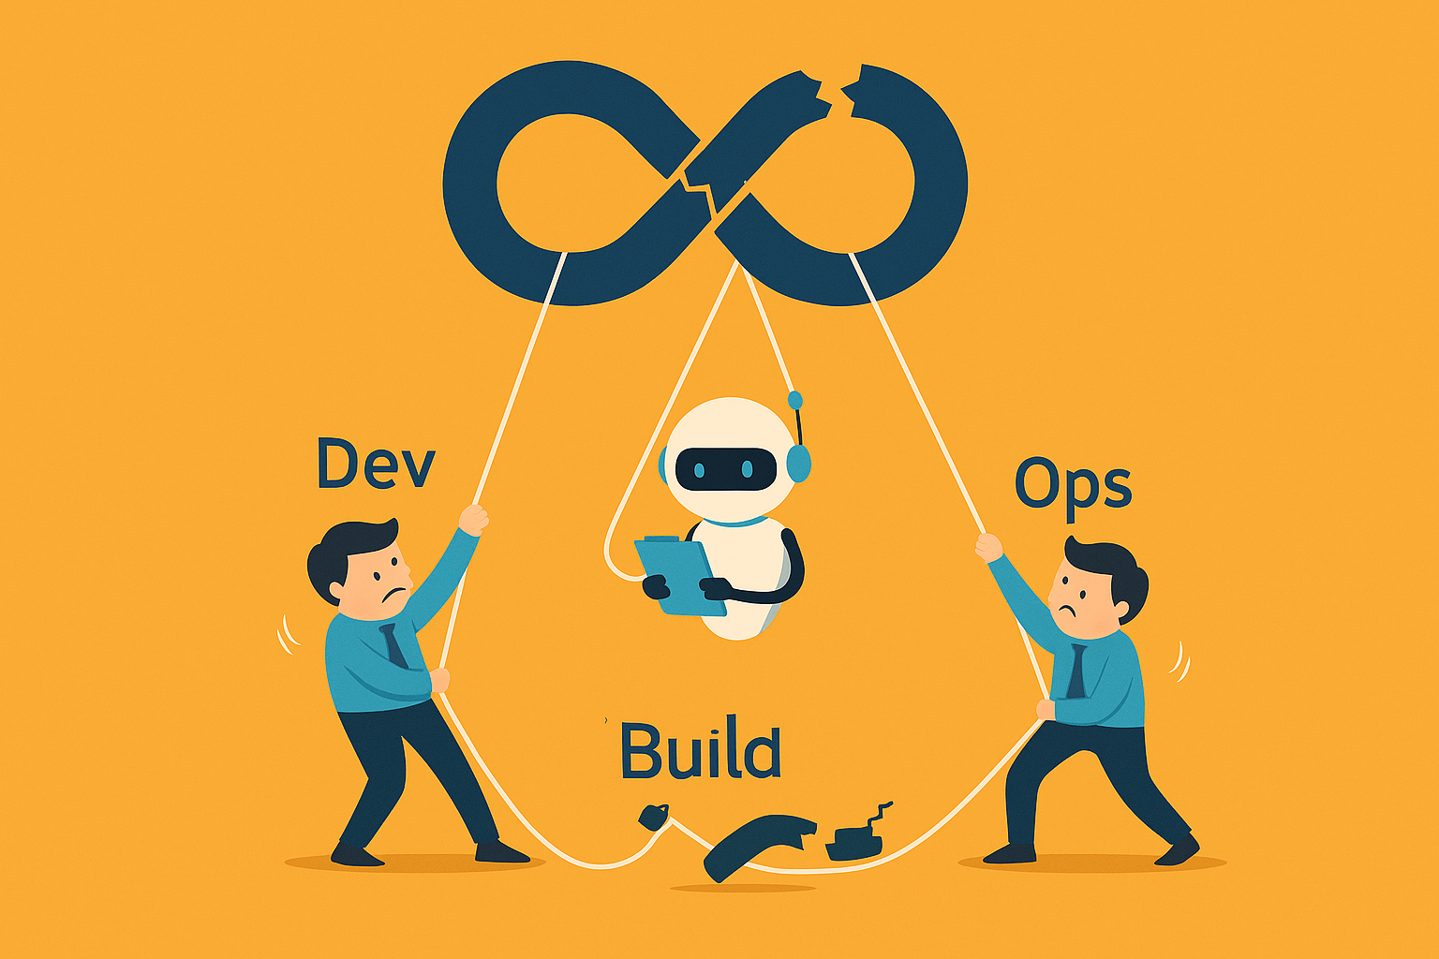
Current DevOps Pipeline Challenges
Unstable Environments
Challenges in Devops Pipelines
Build and test environments are prone to instability.
Today’s DevOps pipelines are responsible for managing complex build, test, and deployment activities.
While they enable faster delivery, many still rely on traditional methods and fragmented tools to operate.
Long Feedback Loops
CI/CD feedback loops are excessively long.
Poor Test Optimization
Test execution is not optimized effectively.
High Manual Debugging
Significant manual debugging and firefighting efforts are required.
Limited Insights
Predictive insights are limited or unavailable.

Slide 4
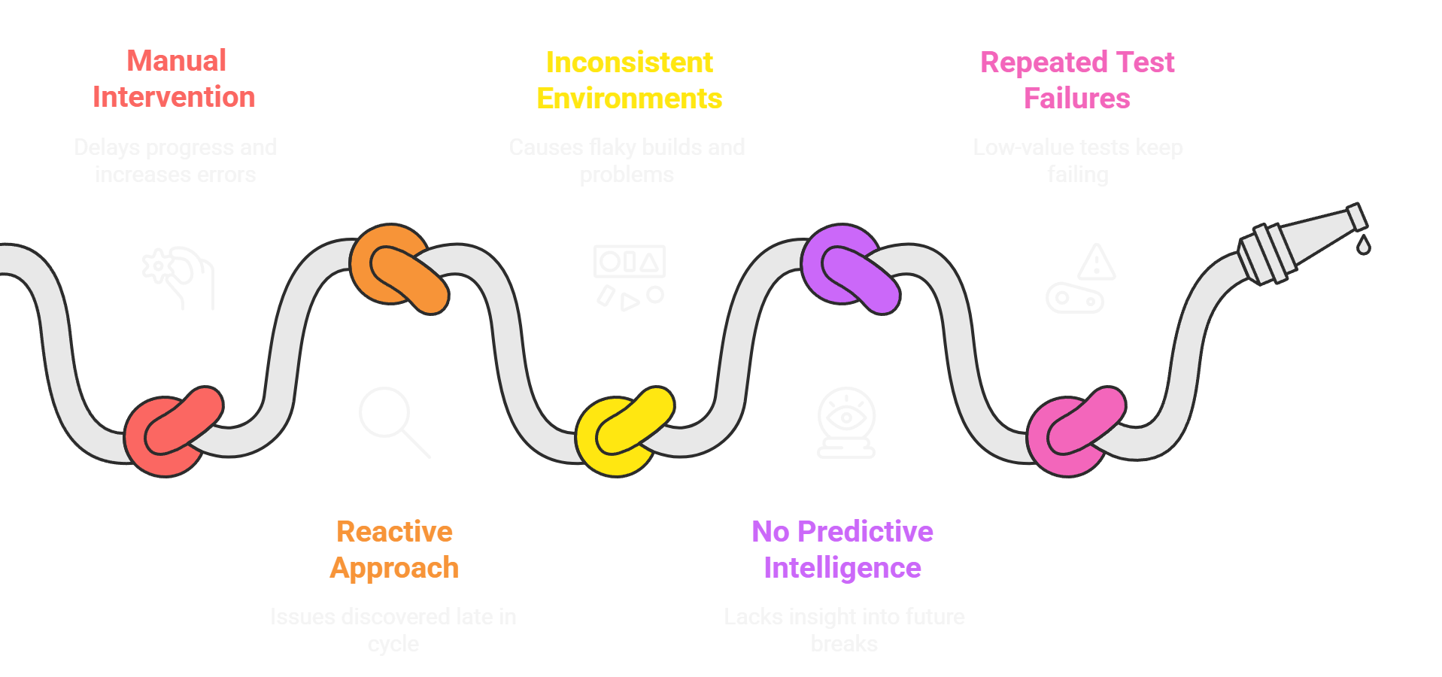
Why Traditional Pipelines Struggle

Slide 5
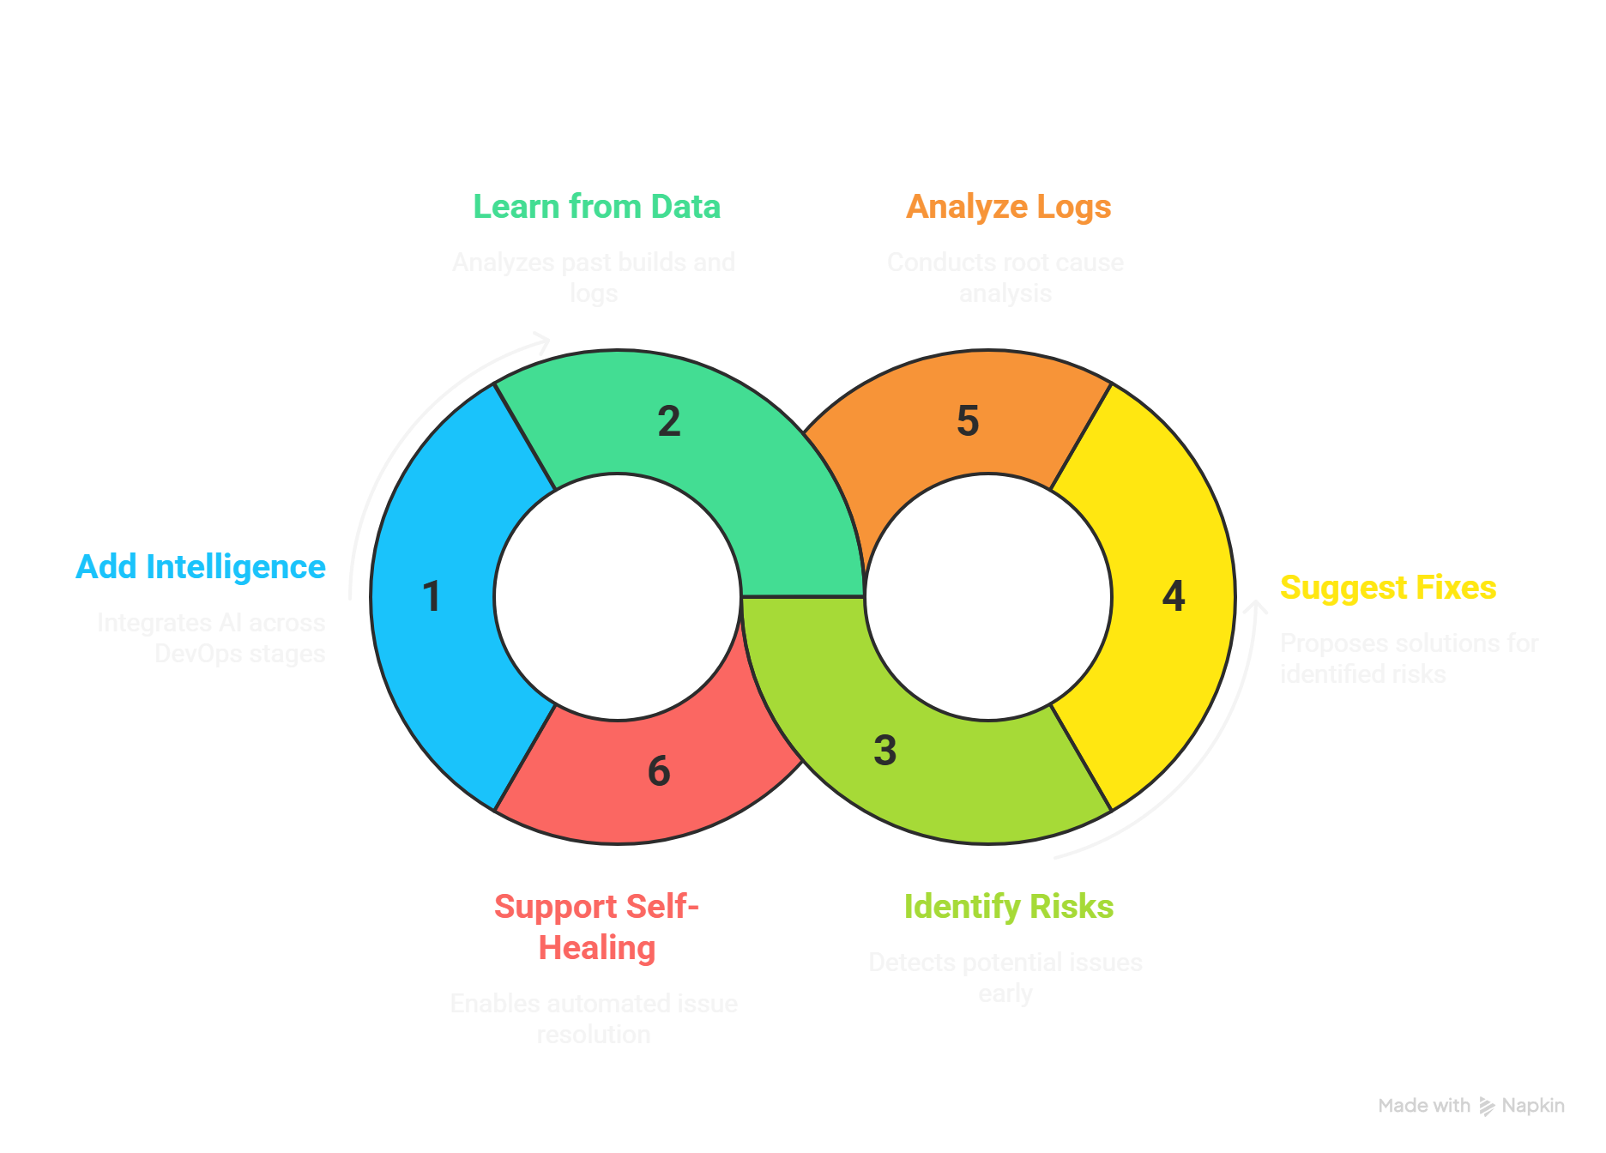
How GenAI Enhances DevOps Pipeline
Adds intelligence across the pipeline (build, test, deploy, monitor)
Learns from past builds, tests, deployments, logs
Identifies risks early and suggests fixes
Provides root cause analysis from logs & traces
Supports self-healing environments

Slide 6


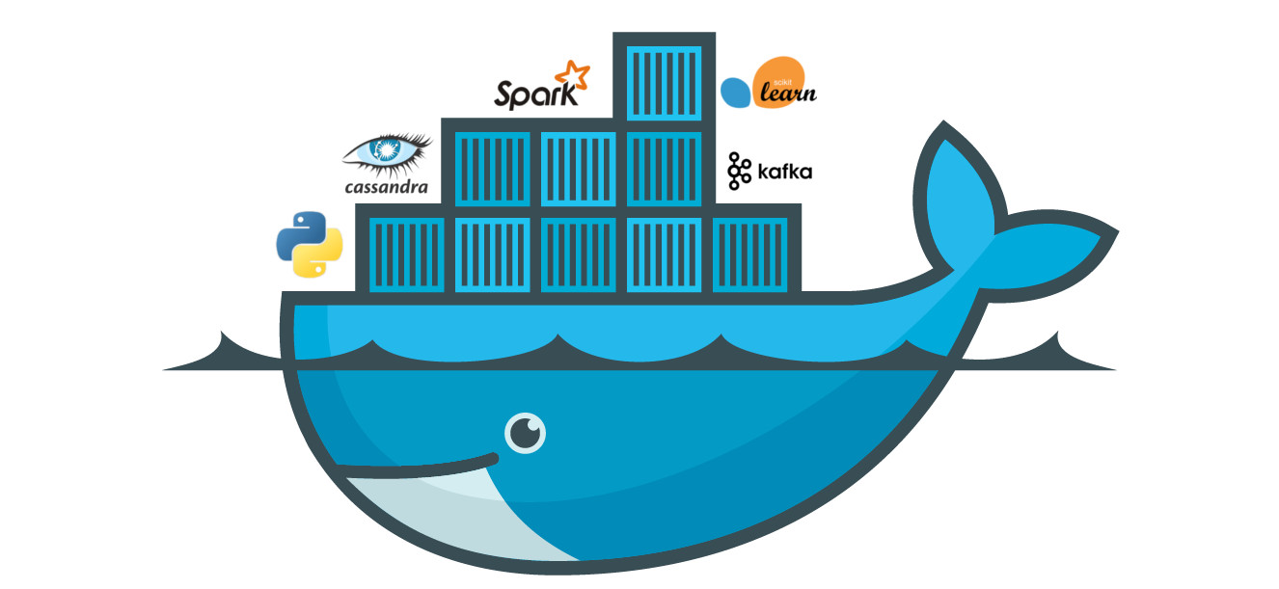











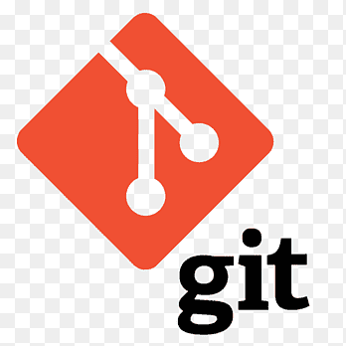







GenAI Architecture
Azure DevOps
Dev Workstation
Azure DevOps Pipeline
Genai Brain
Self Healing
Playwright E2E
Build
Docker Azure registry container
Suggest Fixes
React
Test
Localhost80 playwright Test Result
Nodejs
Infra Suggestions
Vs code
GitHub
Azure OpenAI
MCP
MongoDB
Deploy
AKS Cluster Kubernetes Load balancer
Risk Detection
Git
Auto Generate Tests
Monitor
Azure Monitor Grafana Notifications
Root Cause Analysis
GitHub copilot

Slide 7
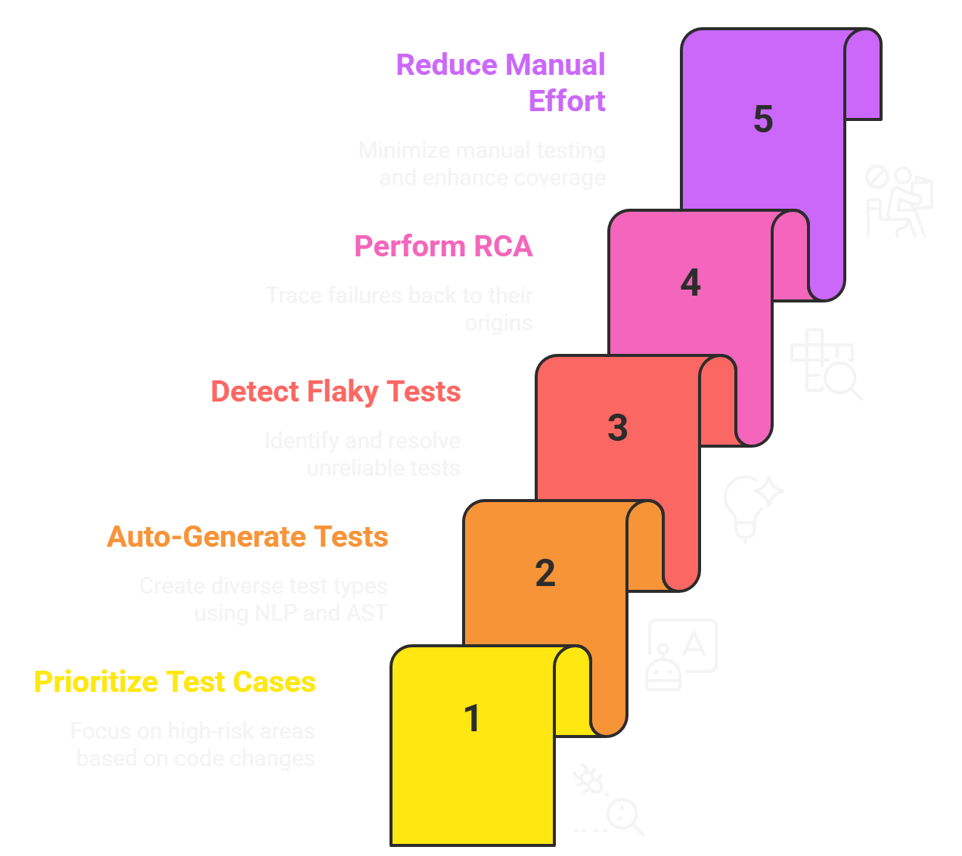
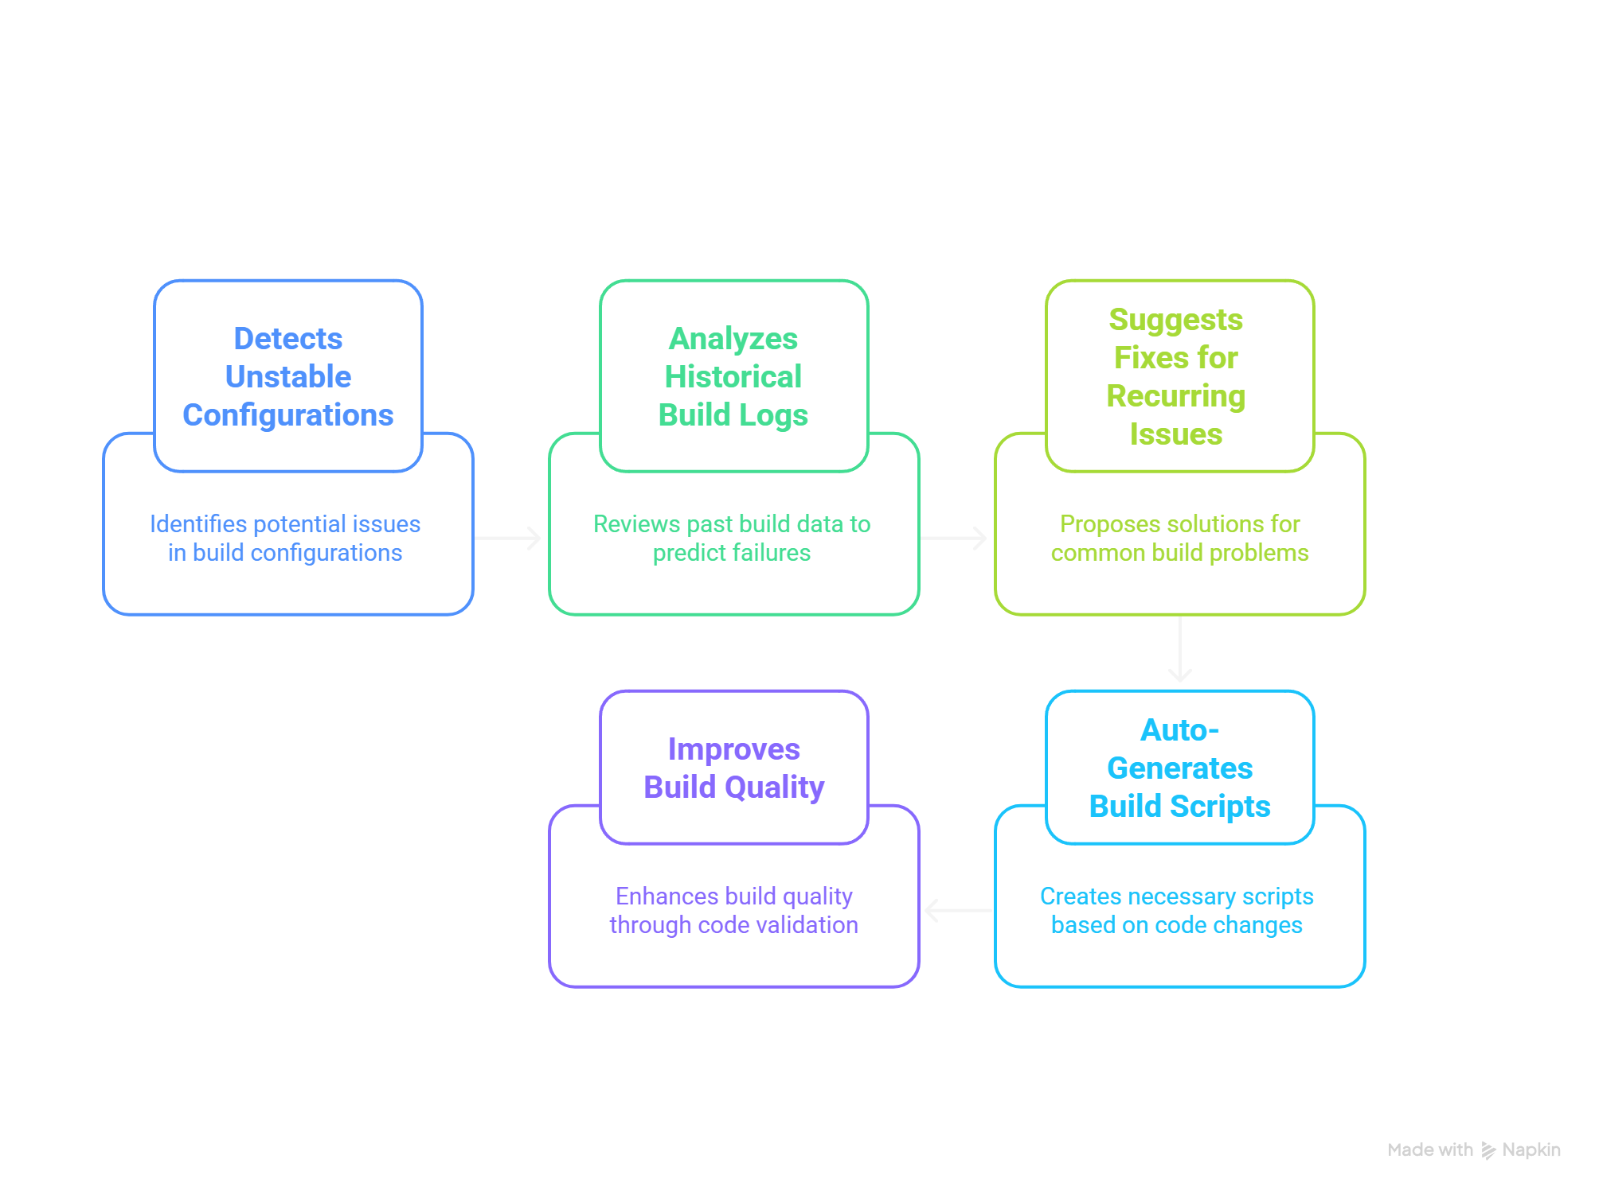
GenAI in Build & Testing Stage
Improving Build Stability & Speed With Intelligent Automation
Making Testing Faster, Smarter And Rish-aware

Slide 8
GenAI in Deployment
Smarter Deployment Strategies
Recommend Rollout Windows
Analyze Pre-Deploy Metrics
Recommends optimal rollout windows based on success rates
Predicts release risks by analyzing metricst.
Suggest Deployment Strategy
Improve Deployment Confidence
Suggests best-fit deployment strategy using change impact analysis
Improves deployment confidence across multi-service/multi-cloud pipelines
Automate Rollback Logic
Automates rollback logic by identifying critical thresholds

Slide 9





GenAI in Monitoring
Intelligence from Logs, Metrics and Traces
Continuous Analysis
Anomaly Detection
Corrective Actions
Self-Healing Workflows
CI/CD Feedback
Feeds observability insights back into CI/CD pipelines for continuous improvement.
Analyzes live metrics, logs, and traces from CloudWatch and Grafana.
Identifies anomalies or degradation patterns in CPU, latency, and memory leaks.
Suggests corrective actions such as auto-scaling, pod restarts, or configuration reverts.
Triggers self-healing workflows using pre-trained models for automated issue resolution.

Slide 10
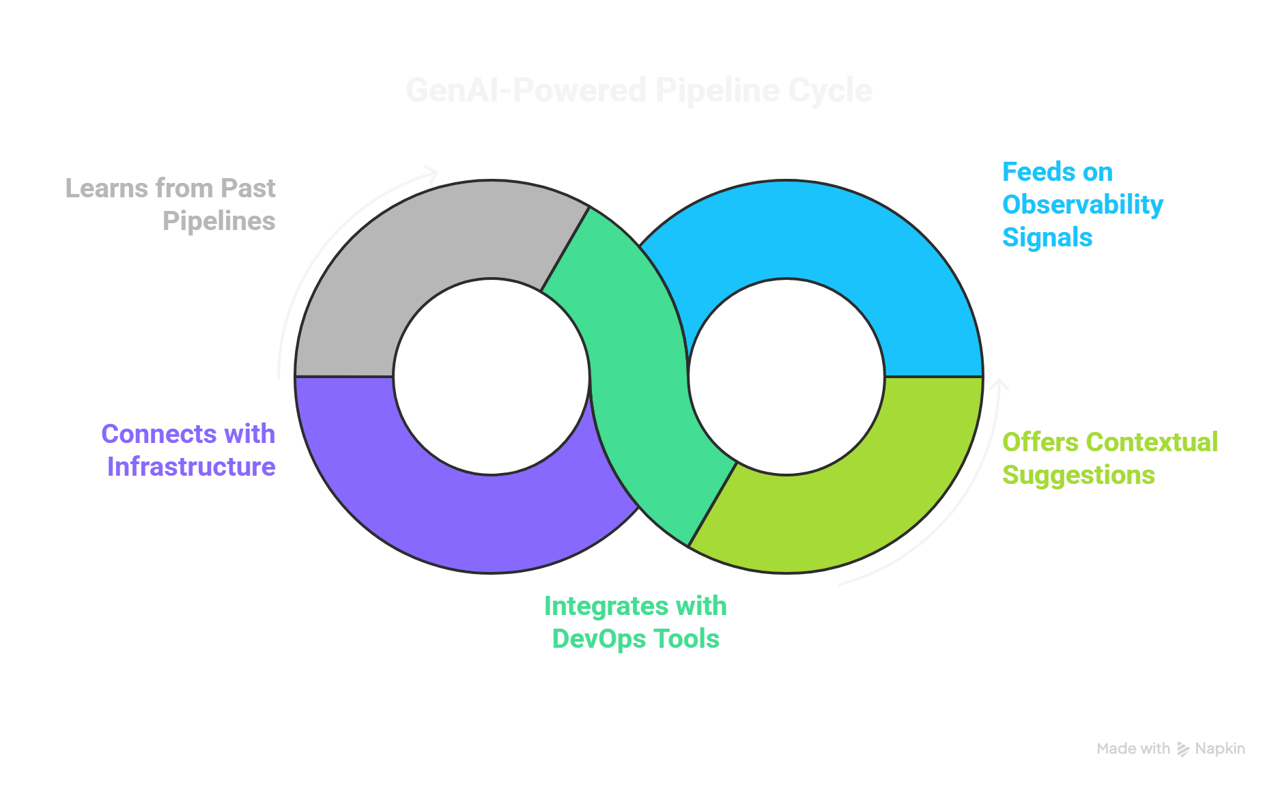
Central GenAI Brain
Learns from all past pipelines: build failures, flaky tests, slow deployments
Integrates into GitHub Actions / Jenkins / Azure DevOps as plugins or hooks
Offers contextual suggestions inside developer IDEs
Feeds on observability signals to improve pipeline intelligence
Connects with artifact stores, infra-as-code, test suites, and monitoring dashboards

Slide 11
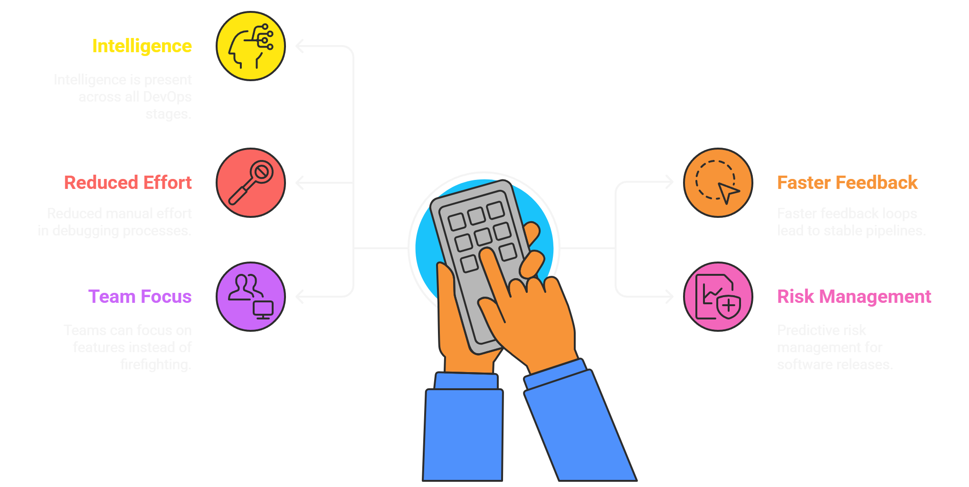
Benefits & Key Takeaways

